Slide 1
DATA SCIENCE
STROKE - CEREBROVASCULAR ACCIDENTS
Solution to a problem of CLASSIFICATION
DATA SCIENCE
González Pluchino, Leandro

Slide 2
Objectives
01
Selection of data to model
02
Exploratory Analysis
03
Dataset preparation
04
Model training (classification)
05
Performance evaluation of models

Slide 3
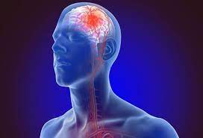

Problem statement
Generate several models that allow us to CLASSIFY strokes.

Slide 4
Dataset
According to the World Health Organization (WHO), stroke is the second leading cause of death worldwide, responsible for approximately 11% of all deaths.
The dataset used will help predict whether a patient is prone to stroke, a type of stroke, based on parameters such as gender, age, various diseases and smoking.
Each ROW of the data provides relevant information about the patient..

Slide 5
1.
Selection of data to model
Detail Dataset Columns:
gender: "Male", "Female" or "Other".
age: age of patient.
hypertension: 0 - if the patient does not have hypertension; 1 - if the patient does have hypertension.
heart_disease: 0 - if the patient does not have heart disease; 1 - if the patient does have heart disease.
ever_married: "No" or "Yes".
work_type: "Children", "Govt_jov", "Never_worked", "Private" or "Self-employment".
Residence_type: "Rural" or "Urban".
avg_glucose_level: average blood glucose level.
bmi: Body mass index.
smoking_status: "previously smoked", "never smoked", "smokes" or "Unknown".
Stroke: 1 - if the patient had a stroke or 0 - otherwise.
1.

Slide 6
1.
Selection of data to model
2.
Dimensions :
(4.981, 11)
#rows = 4.981
#columnas = 11
4.
The variables that will require coding or "dummies" are:
gender
ever_married
work_type
residence_type
smoking_status
3.
We categorize the variable of age -> by age ranges

Slide 7
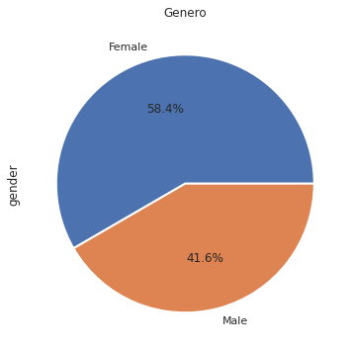
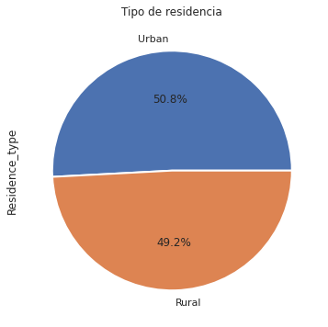
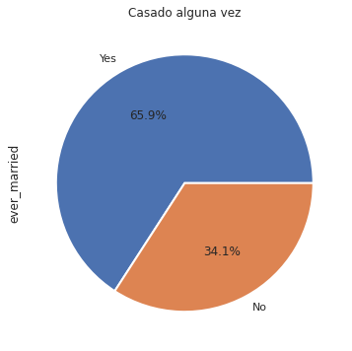
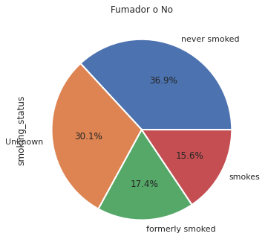
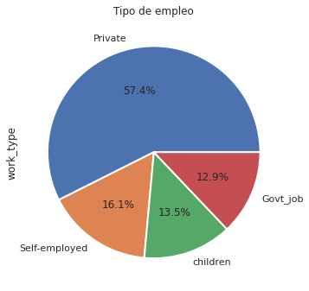
2. Analysis Exploratory

Slide 8
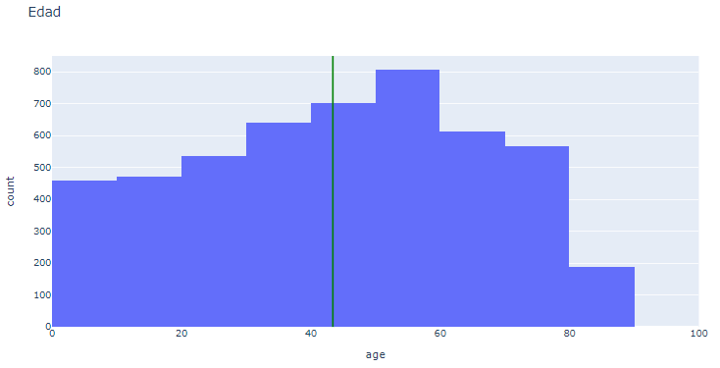
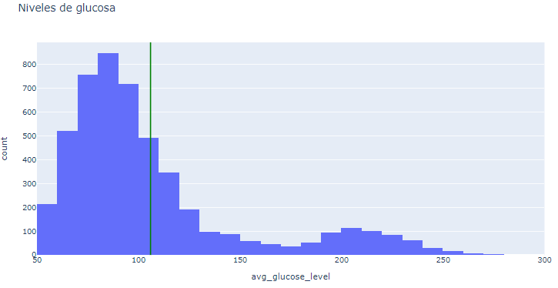
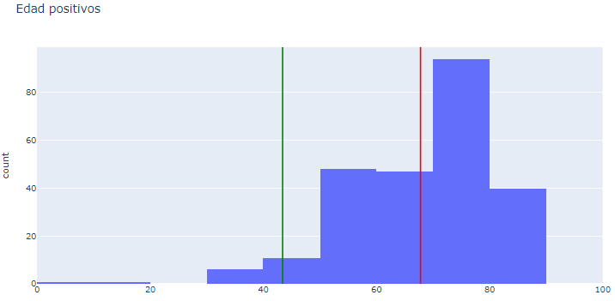
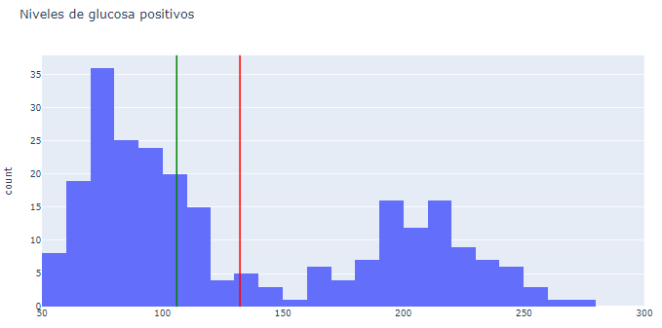
Risk Factors

Slide 9
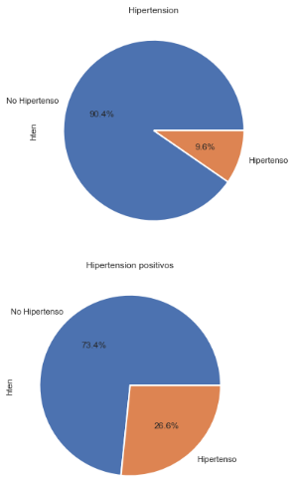
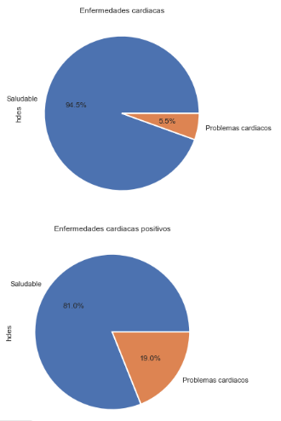
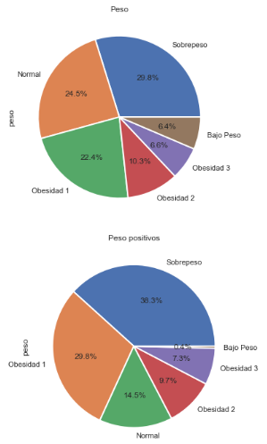
Other risk factors

Slide 10
2.
Training of models
Variable Target = "Stroke".
Variables Features = 1. gender
2. age
3. hypertension
4. heart_disease
5. ever_married
6. work_type
7. Residence_type
8. avg_glucose_level
9. bmi
10. smoking_status

Slide 11
3.
Dataset preparation
1.
“Dummification” of Features
gender
ever_married
work_type
Residence_type
smoking_status
2.
Separation of the Dataset into Training and Test Sets

Slide 12
4.
Model training (Classification)
N° | Model | Data Type | Scaling ? | Hyperparameter
1 | GaussianNB | All | No | -
2 | GaussianNB | All | Yes | -
3 | MultinomialNB | All | No | -
4 | GaussianNB | Numerical | No | -
5 | GaussianNB | Categorical | No | -
6 | GaussianNB | Numerical + Categorical | No | -
7 | MixedB | All | No | -
8 | LogisticRegression | All | No | 0,5
9 | KNN | All | No | 5
10 | KNN | All | Yes | 5

Slide 13
5.
Performance evaluation of the models
N° | Model | Accuracy | Precision | Recall | F1 - Score | Specificity
1 | GaussianNB | 0,82 | 0,14 | 0,51 | 0,22 | 0,83
2 | GaussianNB | 0,82 | 0,13 | 0,50 | 0,22 | 0,84
3 | MultinomialNB | 0,81 | 0,11 | 0,40 | 0,18 | 0,84
4 | GaussianNB | 0,90 | 0,11 | 0,15 | 0,13 | 0,94
5 | GaussianNB | 0,86 | 0,13 | 0,32 | 0,19 | 0,89
6 | GaussianNB | 0,87 | - | - | - | -
7 | MixedB | 0,55 | - | - | - | -
8 | LogisticRegression | 0,95 | NaN | 0 | NaN | 1
9 | KNN | 0,94 | 0 | 0 | NaN | 0,99
10 | KNN | 0,94 | 0,1 | 0,02 | 0,03 | 0,99

Slide 14
We suspect there is a data problem based on the metrics of the latest models....
Preliminary Conclusion
We found that the samples were biased toward negative cases in a 1:20 ratio.

Slide 15
5.
Performance evaluation of the models
N° | Model | Accuracy | Precision | Recall | F1 - Score | Specificity
1 | GaussianNB | 0,76 | 0,53 | 0,47 | 0,50 | 0,86
3 | MultinomialNB | 0,61 | 0,34 | 0,57 | 0,42 | 0,63
8 | LogisticRegression | 0,78 | 0,60 | 0,30 | 0,4 | 0,93
10 | KNN | 0,75 | 0,49 | 0,32 | 0,39 | 0,89
Evaluation of metrics with the data set balanced in a ratio of 1:3

Slide 16

Best performance model...
And the Winner is…
Logistic Regression
Accuracy = 0.78
Precision = 0.60
N° 8

Slide 17
After rebalancing the ratio between the classes to be predicted, we noticed that if we look only at ACCURACY, the performance of the models decreased, but... on the other hand, we managed to optimize the ACCURACY of the models, a metric that allows us to reach the proposed group objective: "to identify the True Positive (VP) cases".
Final Conclusion

Slide 18
THANK YOU VERY MUCH!
DATA SCIENCE
Leandro González Pluchino

